Slide 1
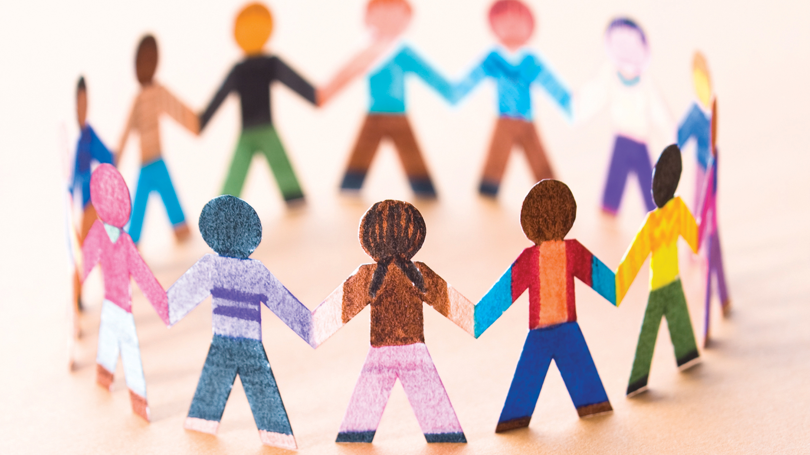

Social events for students

Slide 2




Target audience
CMSC Students
Normal people
Undergraduate students
Alumni
Graduate students

Slide 3



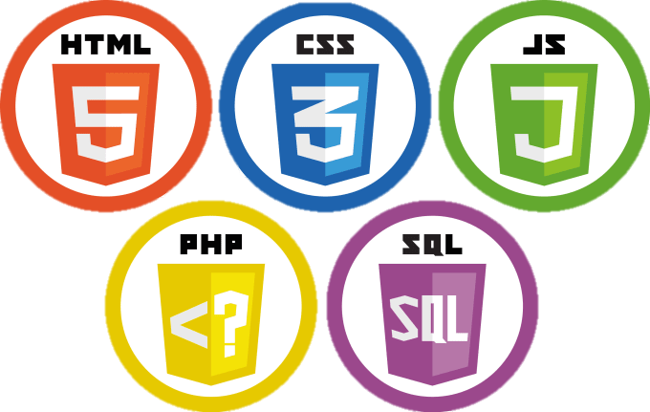

Project Description
Project Description
1
2
3
Languages
Libraries
Server
HTML
PHP 7
JS
CSS
MariaDb
Bootstrap
DHTMLX
Webhost000
https://jeremybell.000webhostapp.com/jaja/

Slide 4
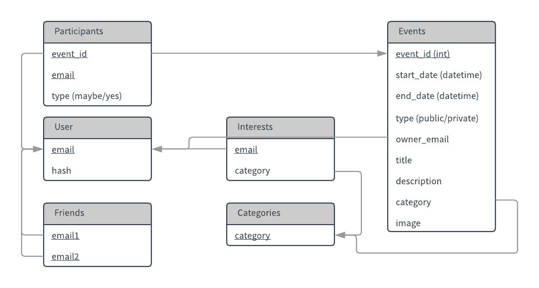
Project Description
Project Description
Logical schema

Slide 5
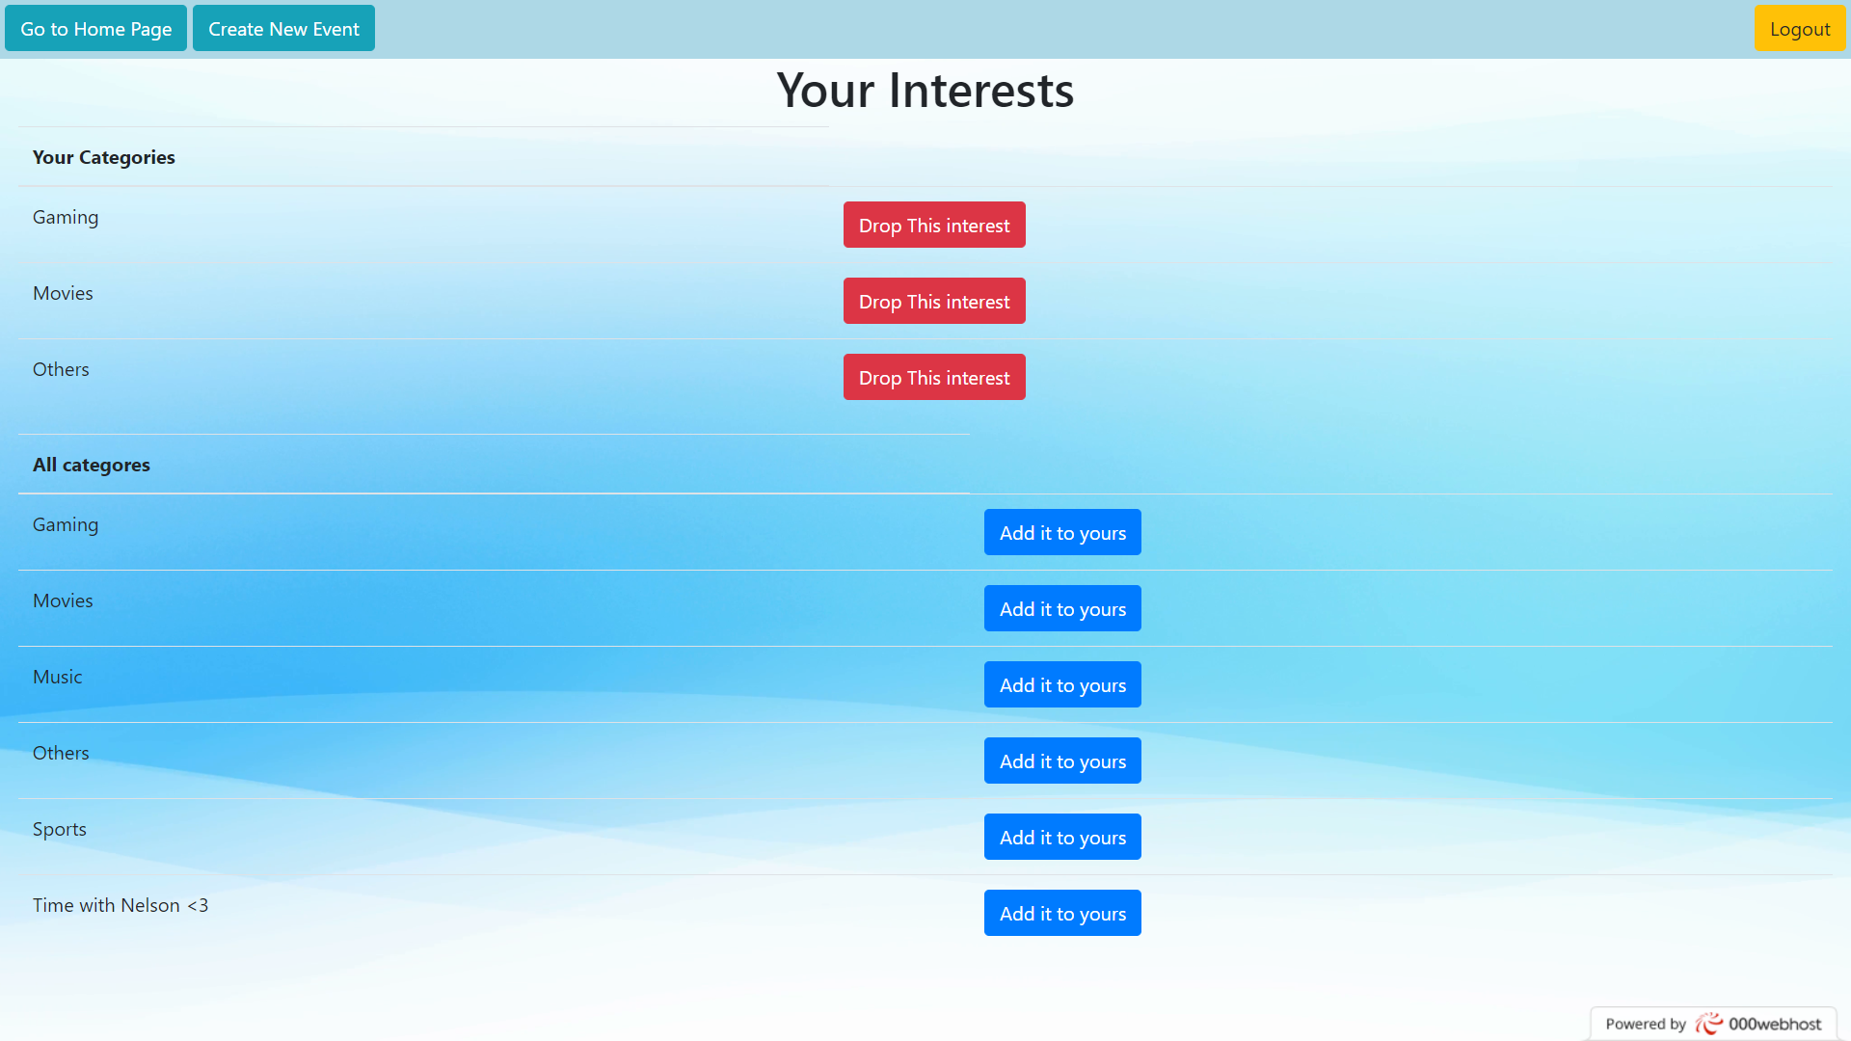
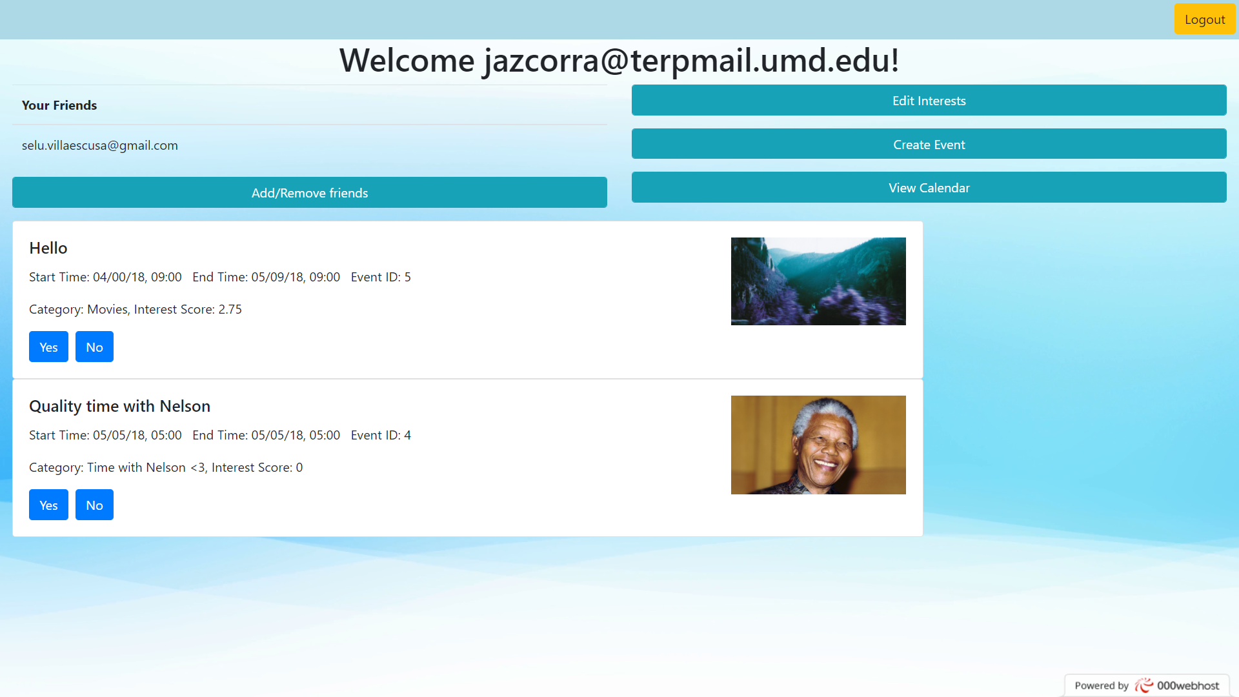
Project Description
Assisting events

Slide 6
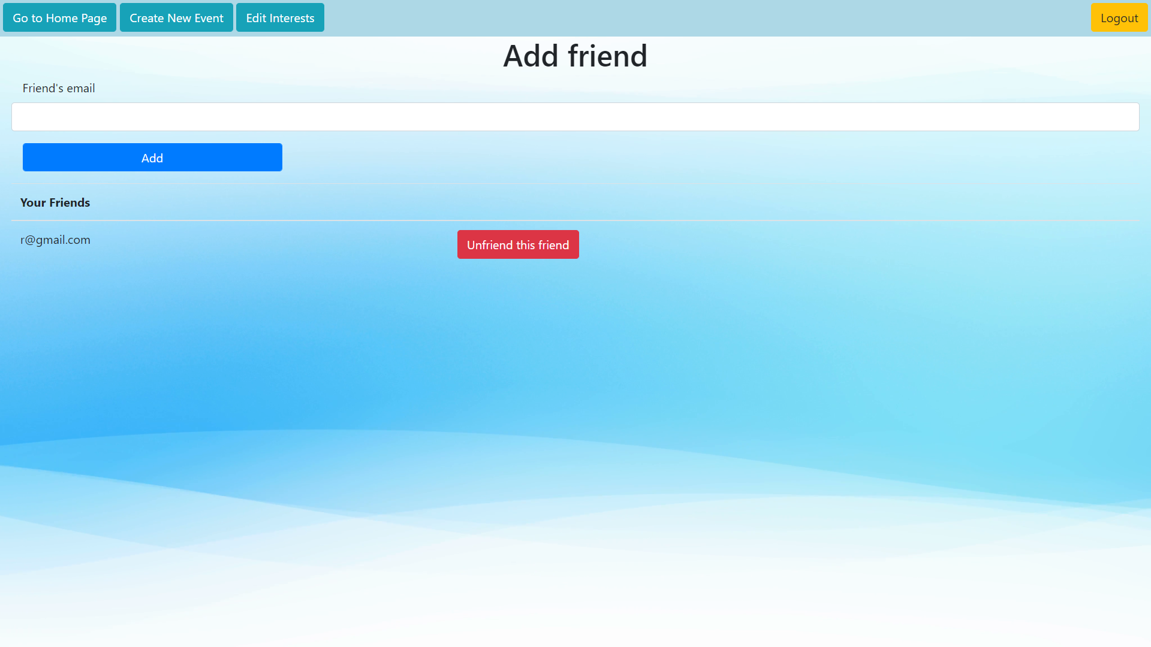
Project Description
Making Friends
Add friends by email
Unfriend

Slide 7
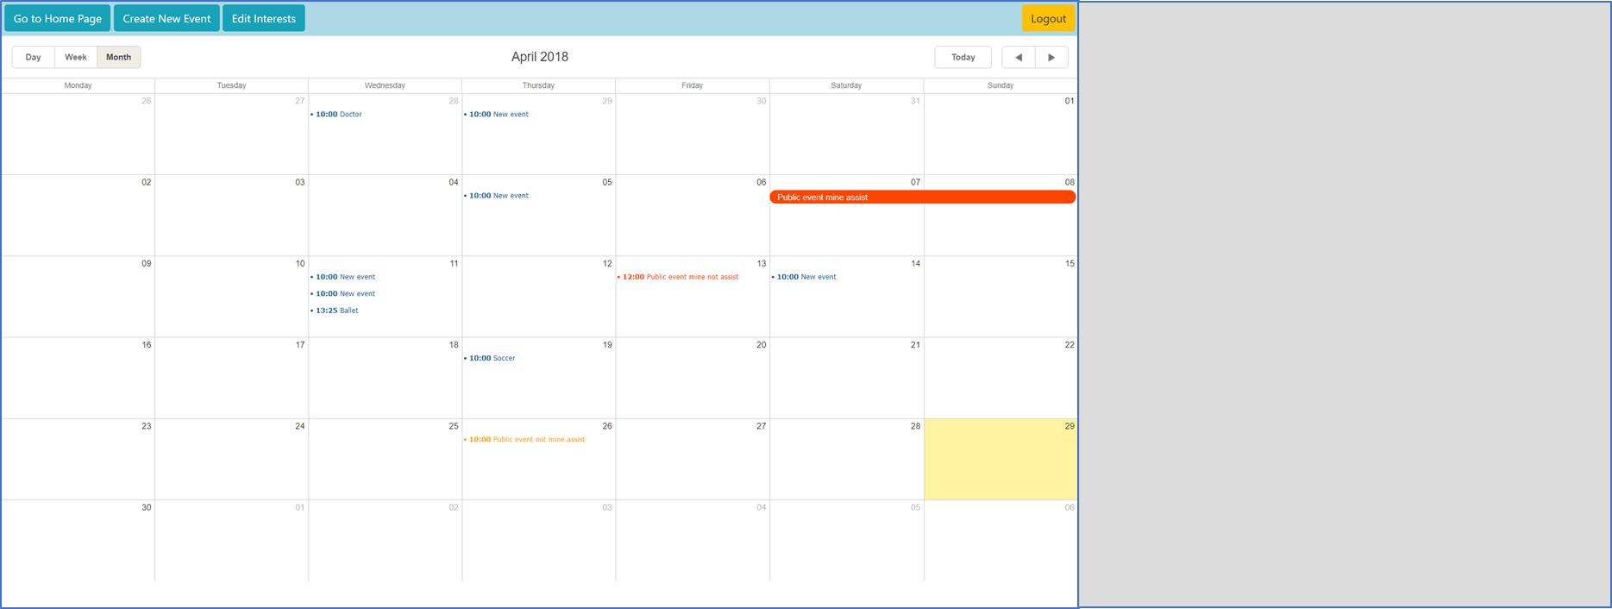
Project Description
Organizing yourself
Insert Private events
View:
Own private events
Public events created by you
Public events you will asssist
Edit:
Own private events
Public events created by you
View Modes
Day/Week/Month

